Slide 1
OpenSAMM Training
Bart De Win Sebastien Deleersnyder Bart.DeWin@owasp.org seba@owasp.org
OWASP AppSec EU 2014 Training, June 24

Slide 2




Bart / Seba ?
Sebastien Deleersnyder
15+ years developer / information security experience
Belgian OWASP chapter founder
OWASP volunteer
Co-organizer www.BruCON.org
Application security specialist Toreon
Bart De Win, Ph.D.
15+ years experience in secure software development
Belgian OWASP chapter co-leader
Author of >60 publications
Security consultant PwC

Slide 3
This training ?
Goal is to discuss how to apply OpenSAMM in practice
Looking into different parts from a practical perspective
Based on the case of your own company
Discussing some of the challenges that you might face
Open interaction session
Notes:
OpenSAMM = global picture of secure software
Do poll for knowledge/use of OpenSAMM

Slide 4
Rules of the House
Turn off mobile phones
Interactive training
Specific discussions about company practices don’t leave this room

Slide 5
Today’s Agenda
Introduction to SDLC and OpenSAMM
Applying OpenSAMM
Methodology
Assessment Governance
Assessment Construction
Assessment Verification
Assessment Deployment
Setting Improvement Targets
OpenSAMM Tools
OpenSAMM Best Practices

Slide 6
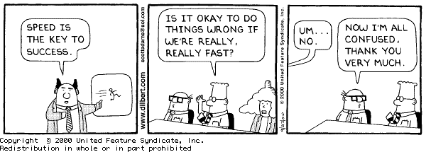
Application Security Problem
75% of vulnerabilities are application related
Software complexity
Technology stacks
Requirements?
Adaptability
Training
Mobile
Growing connectivity
Better
Faster
Cloud

Slide 7

Application Security Symbiosis
Notes:
Picture book Gary. Well chosen …
Build vs. Break
Pos. vs. Negative
Attacker vs. Defender
Should vs. Shouldn’t
Security Functionality vs. Hygiene (Quality)

Slide 8
Application Security during Software Development
Analyse
Design
Implement
Test
Deploy
Maintain

Slide 9
The State-of-Practice in Secure Software Development
Problematic, since:
Focus on bugs, not flaws
Penetration can cause major harm
Not cost efficient
No security assurance
All bugs found ?
Bug fix fixes all occurences ? (also future ?)
Bug fix might introduce new security vulnerabilities
Analyse
Design
Implement
Test
Deploy
Maintain
(Arch review)
Pentest
Penetrate & Patch

Slide 10
SDLC ?
Enterprise-wide software security improvement program
Strategic approach to assure software quality
Goal is to increase systematicity
Focus on security functionality and security hygiene
Analyse
Design
Implement
Test
Deploy
Maintain
SDLC

Slide 11
SDLC Cornerstones
Process
Activities
Control Gates
Knowledge
Standards & Guidelines
Tools & Components
Deliverables
Transfer methods
People
Roles & Responsibilities
Compliance
Development support
Assessment tools
Management tools
Risk
Training
SecAppDev 2013
Notes:
Mental model
Cfr. current E2E process, this is more extensive.
11

Slide 12
Strategic ?
Organizations with a proper SDLC will experience an 80 percent decrease in critical vulnerabilities
Organizations that acquire products and services with just a 50 percent reduction in vulnerabilities will reduce configuration management and incident response costs by 75 percent each.
Notes:
Gartner rapport van 2006
Forrester report 2011: ROI is attainable if you implement and maintain SDLC end-to-end.
Aberdeen report: same result

Slide 13
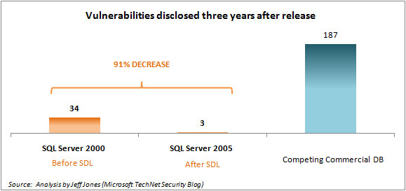
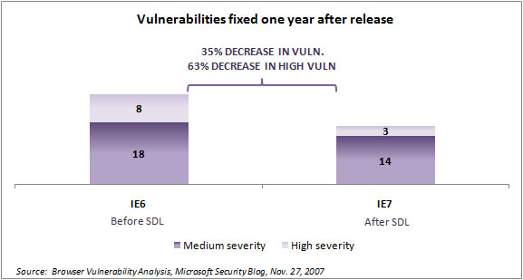
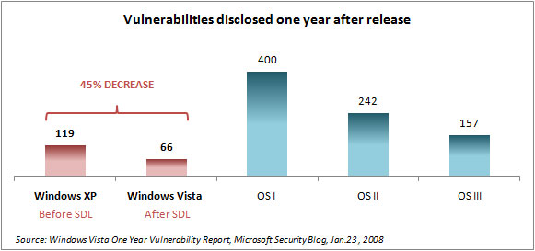
Does it really work ?

Slide 14
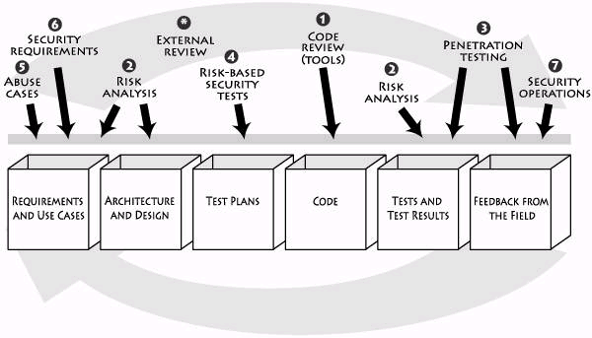
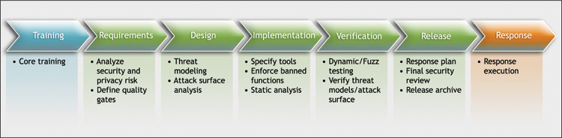



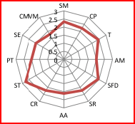

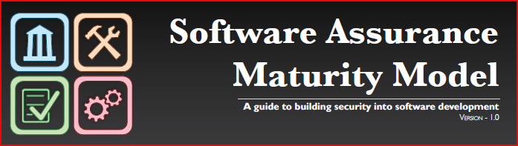
SDLC-related initiatives
TouchPoints
Microsoft SDL
SP800-64
CLASP
SSE-CMM
BSIMM
TSP-Secure
GASSP
SAMM

Slide 15
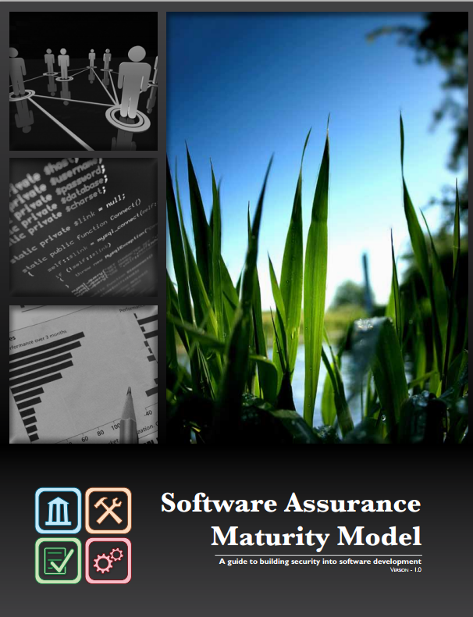
Why a Maturity Model ?
An organization’s behavior changes slowly over time
Changes must be iterative while working toward long-term goals
There is no single recipe that works for all organizations
A solution must enable risk-based choices tailored to the organization
Guidance related to security activities must be prescriptive
A solution must provide enough details for non-security-people
Overall, must be simple, well-defined, and measurable
OWASP Software Assurance Maturity Model (SAMM)
https://www.owasp.org/index.php/Category:Software_Assurance_Maturity_Model

Slide 16

OpenSAMM 101 – Introduction to the model

Slide 17




SAMM Business Functions
Start with the core activities tied to any organization performing software development
Named generically, but should resonate with any developer or manager

Slide 18
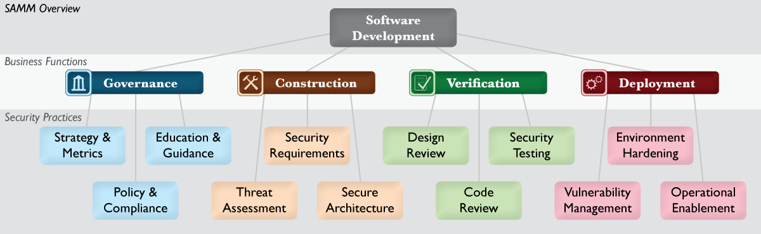
SAMM Security Practices
From each of the Business Functions, 3 Security Practices are defined
The Security Practices cover all areas relevant to software security assurance
Each one is a ‘silo’ for improvement

Slide 19
Under each Security Practice
Three successive Objectives under each Practice define how it can be improved over time
This establishes a notion of a Level at which an organization fulfills a given Practice
The three Levels for a Practice generally correspond to:
(0: Implicit starting point with the Practice unfulfilled)
1: Initial understanding and ad hoc provision of the Practice
2: Increase efficiency and/or effectiveness of the Practice
3: Comprehensive mastery of the Practice at scale

Slide 20
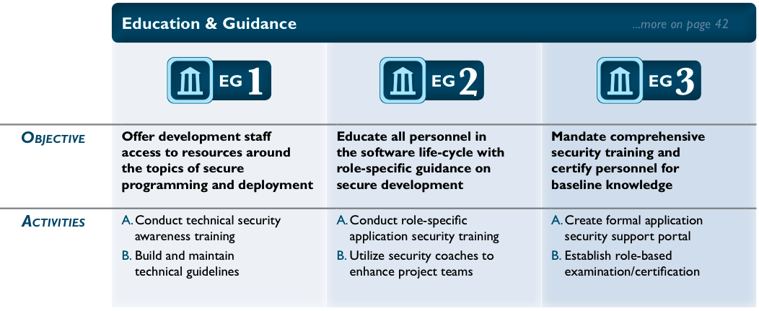
Check out this one...

Slide 21
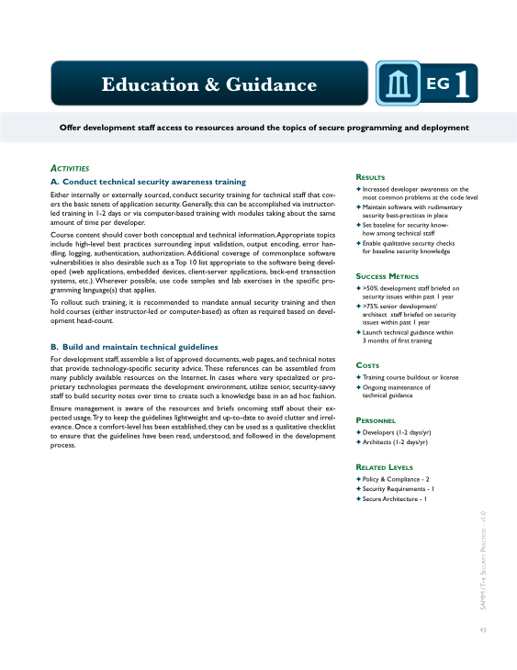
Per Level, SAMM defines...
Objective
Activities
Results
Success Metrics
Costs
Personnel
Related Levels

Slide 22
Approach to iterative improvement
Since the twelve Practices are each a maturity area, the successive Objectives represent the “building blocks” for any assurance program
Simply put, improve an assurance program in phases by:
Select security Practices to improve in next phase of assurance program
Achieve the next Objective in each Practice by performing the corresponding Activities at the specified Success Metrics

Slide 23

Applying the model

Slide 24
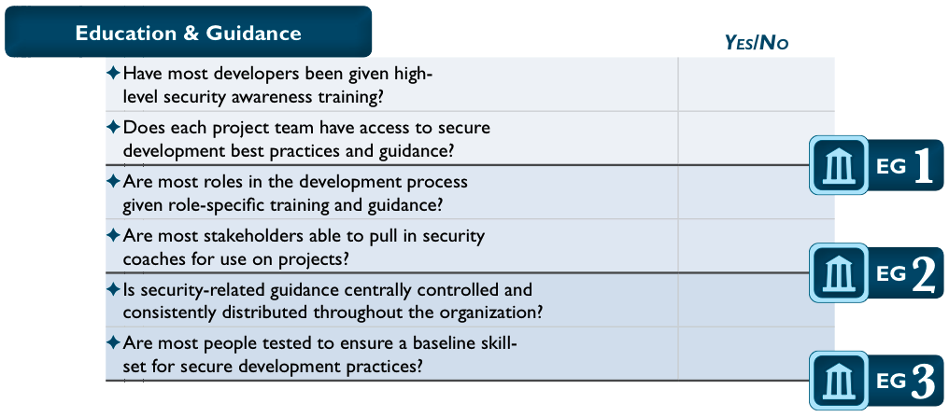
Conducting assessments
SAMM includes assessment worksheets for each Security Practice

Slide 25
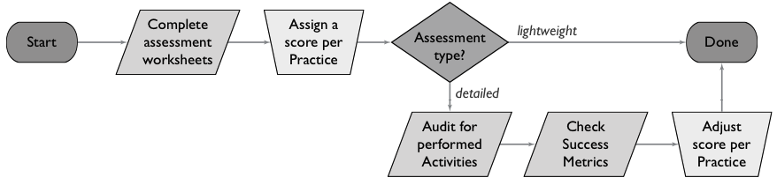

Assessment process
Supports both lightweight and detailed assessments
Organizations may fall in between levels (+)

Slide 26
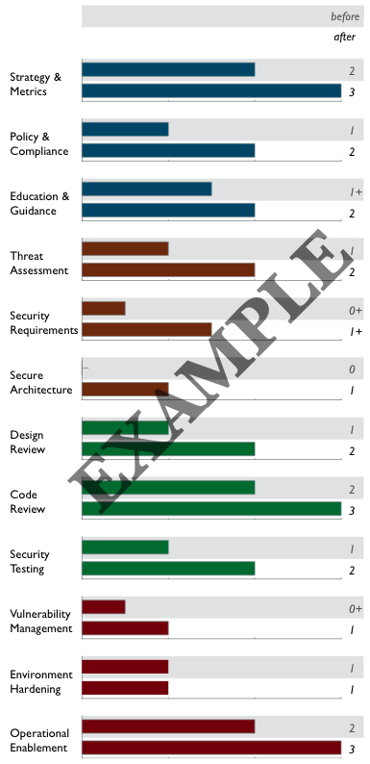
Creating Scorecards
Gap analysis
Capturing scores from detailed assessments versus expected performance levels
Demonstrating improvement
Capturing scores from before and after an iteration of assurance program build-out
Ongoing measurement
Capturing scores over consistent time frames for an assurance program that is already in place

Slide 27
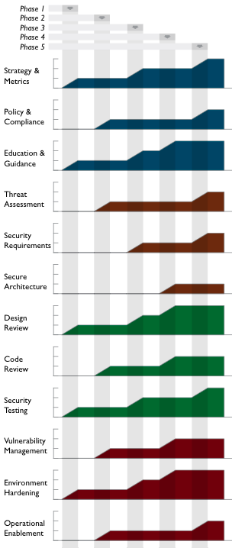
Roadmap templates
To make the “building blocks” usable, SAMM defines Roadmaps templates for typical kinds of organizations
Independent Software Vendors
Online Service Providers
Financial Services Organizations
Government Organizations
Organization types chosen because
They represent common use-cases
Each organization has variations in typical software-induced risk
Optimal creation of an assurance program is different for each

Slide 28
Today’s Agenda
Introduction to SDLC and OpenSAMM
Applying OpenSAMM
Methodology
Assessment Governance
Assessment Construction
Assessment Verification
Assessment Deployment
Setting Improvement Targets
OpenSAMM Tools
OpenSAMM Best Practices

Slide 29

Before you begin
Organizational Context
Realistic Goals ?
Scope ?
Constraints (budget, timing, resources)
Affinity with a particular model ?
Notes:
SDLC is going to cause impact, do realize this !

Slide 30
What’s your Company Maturity ?
In terms of IT strategy and application landscape
In terms of software Development practices
Analysis, Design, Implementation, Testing, Release, Maintenance
In terms of ITSM practices
Configuration, Change, Release, Vulnerability -Mngt.
Company
Maturity
≈
Feasibility
SDLC
Program
Notes:
ITSM = IT Service Management
Standardization

Slide 31

Complicating factors, anyone ?
Different development teams
Different technology stacks
Business-IT alignment issues
Outsourced development
...

Slide 32
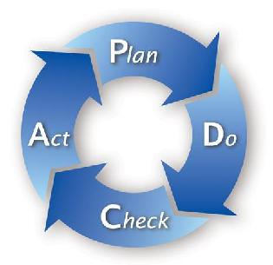
Typical Approach
As-Is
To-Be
Improvements

Slide 33
As-Is
As-Is
To-Be
Improvements
Maturity Evaluation (in your favourite model)
Depending on (your knowledge of) the organisation, you might be able to do this on your own
If not, interviews with different stakeholders will be necessary
Analyst, Architect, Tech Lead, QA, Ops, Governance
Discuss outcome with the stakeholders and present findings to the project advisory board

Slide 34

Scoping
For large companies, teams will perform differently
=> difficult to come up with a single result
Consider
Reducing the scope to a single, uniform unit
splitting the assessment into different organizational subunits
Splitting might be awkward at first, but can be helpful later on for motivational purposes

Slide 35

Assessment Exercises
Use OpenSAMM to evaluate the development practices in your own company
Focus on a specific Business Functions
Applicable to both Waterfall and Agile models
Using distributed sheets and questionnaires

Slide 36
To-Be
As-Is
To-Be
Improvements
Identify the targets for your company
Define staged roadmap and overall planning
Define application migration strategy
Gradual improvements work better than big bang
Have this validated by the project advisory board
Notes:
Application migration strategy:
Which apps can be POCs
What for new application
What for existing applications
Exception mechanism & phasing out

Slide 37
Staged Roadmap
Security Practices/Phase | Start | One | Two | Three
Strategy & metrics | 0,5 | 2 | 2 | 2
Policy & Compliance | 0 | 0,5 | 1 | 1,5
Education & Guidance | 0,5 | 1 | 2 | 2,5
Threat Assessment | 0 | 0,5 | 2 | 2,5
Security Requirements | 0,5 | 1,5 | 2 | 3
Secure Architecture | 0,5 | 1,5 | 2 | 3
Design Review | 0 | 1 | 2 | 2,5
Code Review | 0 | 0,5 | 1,5 | 2,5
Security Testing | 0,5 | 1 | 1,5 | 2,5
Vulnerability Management | 2,5 | 3 | 3 | 3
Environment Hardening | 2,5 | 2,5 | 2,5 | 2,5
Operational Enablement | 0,5 | 0,5 | 1,5 | 3
Total Effort per Phase |  | 7,5 | 7,5 | 7,5
Notes:
37

Slide 38
Improvement Exercise
Define a target for your company and the phased roadmap to get there
Focus on the most urgent/heavy-impact practices first
Try balancing the complexity and effort of the different step-ups

Slide 39
Implementation
As-Is
To-Be
Improvements
Implementation of dedicated activities according to the plan
Iterative, Continuous Process
Leverage good existing practices

Slide 40
Governance
Business Function

Slide 41
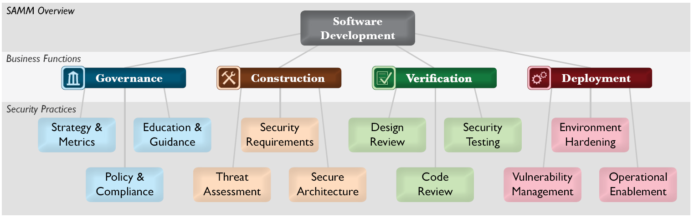
12 Security Practices

Slide 42


Strategy & Metrics
Goal is to establish a software assurance framework within an organisation
Foundation for all other OpenSAMM practices
Characteristics:
Measurable
Aligned with business risk
Driver for continuous improvement and financial guidance
VS.

Slide 43
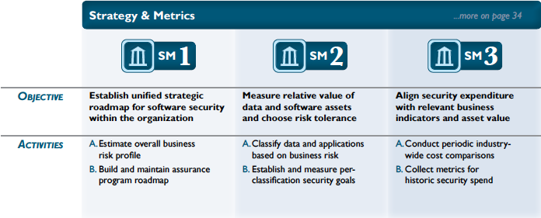
Strategy & Metrics
Notes:
Link with SABSA for financial drivers (based on attributes)

Slide 44

Policy & Compliance
Goal is to understand and adhere to legal and regulatory requirements
Typically external in nature
This is often a very informal practice in organisations !
Characteristics
Organisation-wide vs. project-specific
Scope
Important driver for software security requirements
Notes:
Mostly external in nature

Slide 45
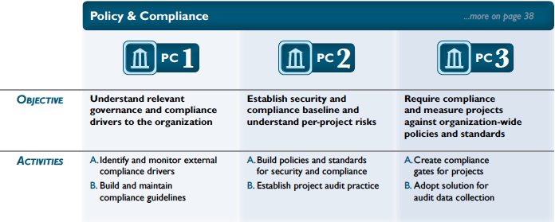
Policy & Compliance

Slide 46

Education & Guidance
Goal is to disseminate security-oriented information to all stakeholders involved in the software development lifecycle
By means of standards, trainings, …
To be integrated with organisation training curriculum
A once-of effort is not sufficient
Teach a fisherman to fish
Technical guidelines form the basis for several other practices

Slide 47
Education & Guidance

Slide 48
Assessment Exercise
Use OpenSAMM to evaluate the development practices in your own company
Focus on Governance Business Function
Applicable to both Waterfall and Agile models
Using distributed sheets and questionnaires

Slide 49
Assessment wrap-up
What’s your company’s score ?
What’s the average scores for the group ?
Any odd ratings ?

Slide 50
Construction
Business Function

Slide 51
12 Security Practices

Slide 52
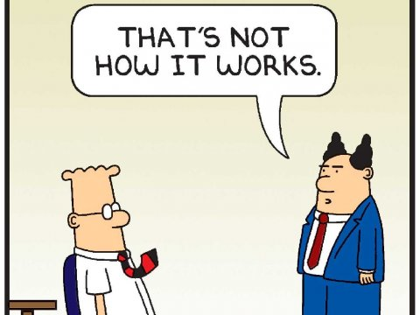
Threat Assessment
The goal of this practice is to focus on the attacker perspective of things
To make sure that security is not only functionality-driven
Remember that software security = white + black
Very common practice in safety-critical systems
Less so in others
This is where “the magic” kicks in
Your imagination is the limit

Slide 53
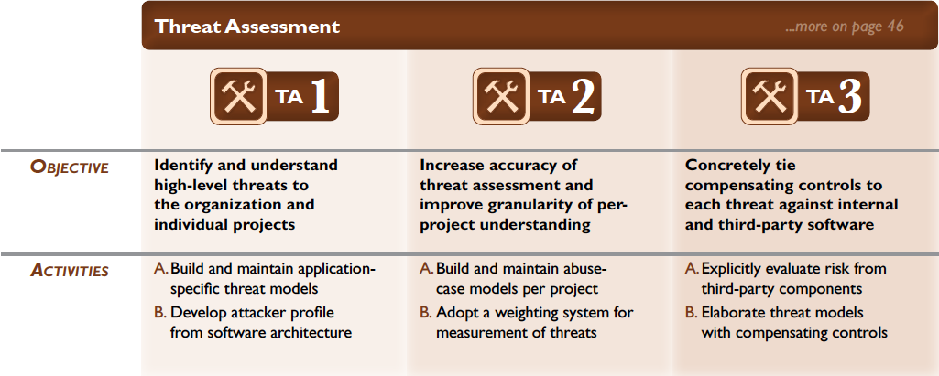
Threat Assessment

Slide 54
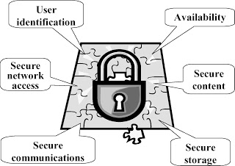
Security Requirements
Goal is to make security specification more explicit
Turn security into a positively-spaced problem
Source of security requirements
Compliance
Standard
Functionality
Quality
Requirements should be specified in a S.M.A.R.T. way
Notes:
SMART = specific, measurable, achievable, relevant, time-bound

Slide 55
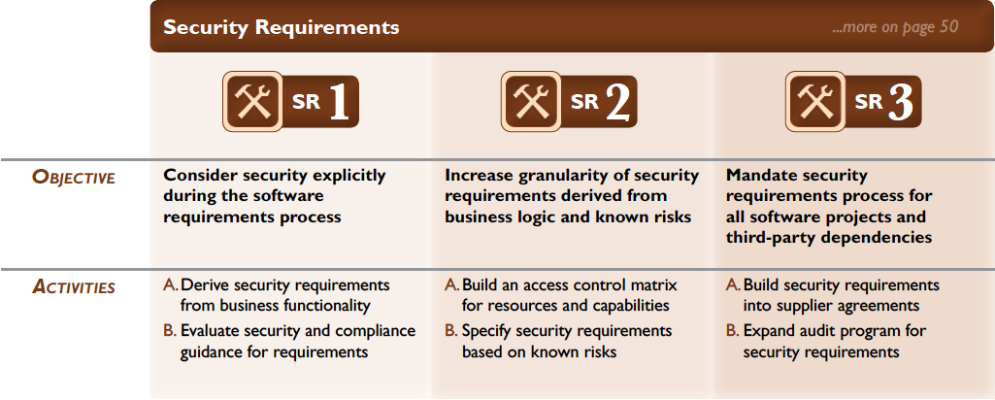
Security Requirements

Slide 56
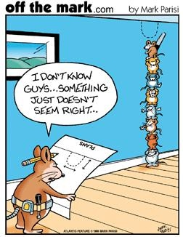
Security Architecture
Key practice for security
Poor decisions at this step can have major impact, and are often difficult (or costly) to fix.
Characteristics
Take into account security principles
Risk is a factor of all components (incl. 3rd party)
Use proven solutions
Don’t roll you own crypto
Use company standards and best practices

Slide 57
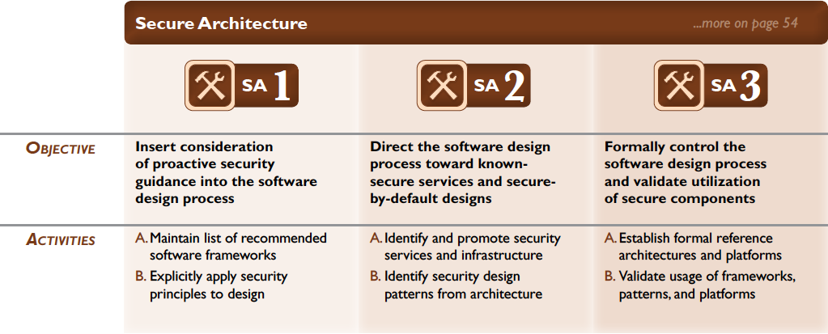
Secure Architecture

Slide 58
Assessment Exercise
Use OpenSAMM to evaluate the development practices in your own company
Focus on Construction Business Function
Applicable to both Waterfall and Agile models
Using distributed sheets and questionnaires

Slide 59
Assessment wrap-up
What’s your company’s score ?
What’s the average scores for the group ?
Any odd ratings ?

Slide 60
Verification
Business Function

Slide 61
12 Security Practices

Slide 62
Design Review
software design security review
ensure known risks are covered
cross-check security design best practices
security assessment of attack surface, software design and architecture
lightweight activities => formal inspection of data flows & security mechanisms
enforcement of baseline expectations for conducting design assessments and reviewing findings before releases are accepted.
Assess and validate artifacts to understand protection mechanisms
Notes:
fixme: insert DFD / Architecture overview?

Slide 63
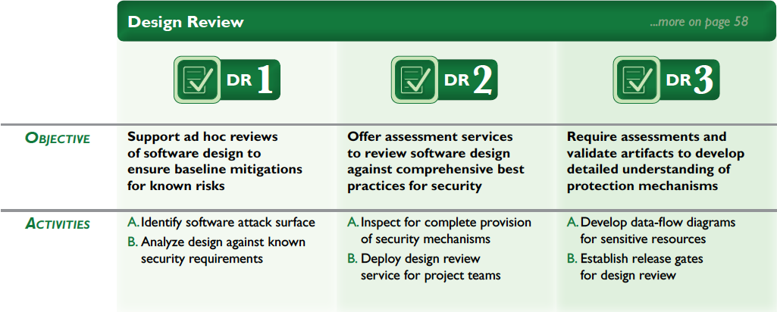
Design Review

Slide 64
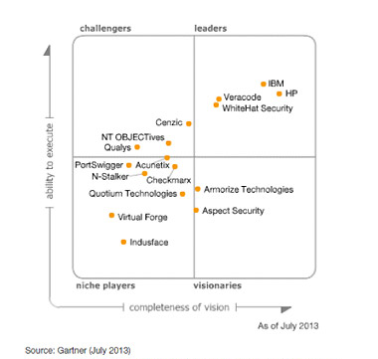
Code Review
Start
lightweight checklists
inspect critical software
Improve
Automation
Increase coverage / efficacy
Mature
Integrate in development
Produce audit evidence
Test & production release gates
Assessment of source code:
vulnerability discovery
related mitigation activities
establish secure coding baseline
Will require tool investment:
Language specific
Basic open source tooling
Commercial tools maturing
Process & education important!

Slide 65
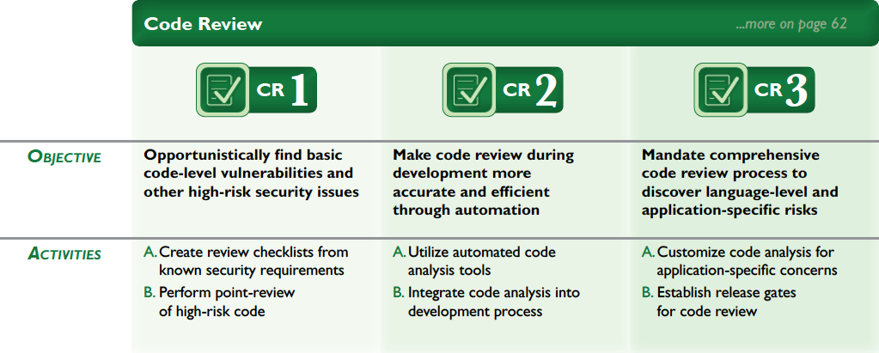
Code Review

Slide 66
Security Testing
Dynamic security testing
Detect vulnerabilities & misconfigurations
penetration testing => automation
Based on security & compliance requirements / checklist of common vulnerabilities
Manual testing can be done, scaled with tooling: intercepting proxy and/or scanner
Detected defects will require validation, risk analysis & recommendations to fix
Automate to repeat tests for each release
Introduce security test-driven development
Test results to be reported to & accepted by owner for each deployment
Notes:
fixme – insert list of tools

Slide 67
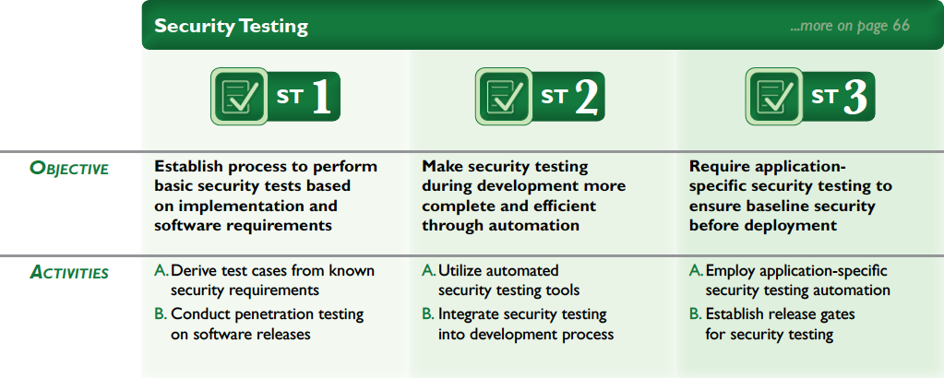
Security Testing

Slide 68
Assessment Exercise
Use OpenSAMM to evaluate the development practices in your own company
Focus on Verification Business Functions
Applicable to both Waterfall and Agile models
Using distributed sheets and questionnaires

Slide 69
Assessment wrap-up
What’s your company’s score ?
What’s the average scores for the group ?
Any odd ratings ?

Slide 70
Deployment
Business Function

Slide 71
12 Security Practices

Slide 72
Vulnerability Management
Prepare for WHEN, not IF!
Symptoms of malfunctioning SDLC
handling vulnerability reports and operational incidents
lightweight rile assignment of roles=> formal incident response & communication process
Use vulnerability metrics and root-cause analysis to improve SDLC
spoc per team & security response team
communication & information flow is key!
patch release process & responsible/legal disclosure

Slide 73
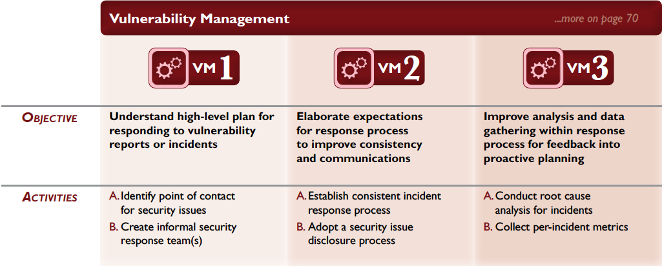
Vulnerability Management

Slide 74
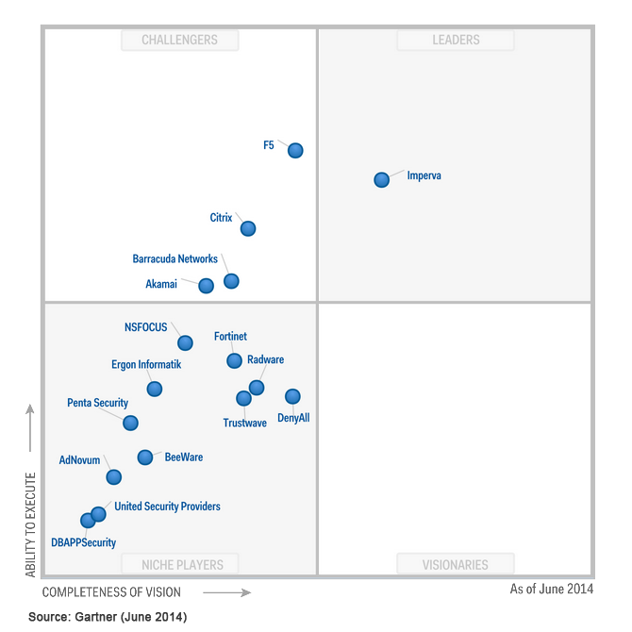
Environment Hardening
Underlying infrastructure hardening
Track (3rd party) libraries & components
TOP-10 - A9 – Using Known Vulnerable Components
Add WAF layer (virtual patching)
ModSecurity

Slide 75
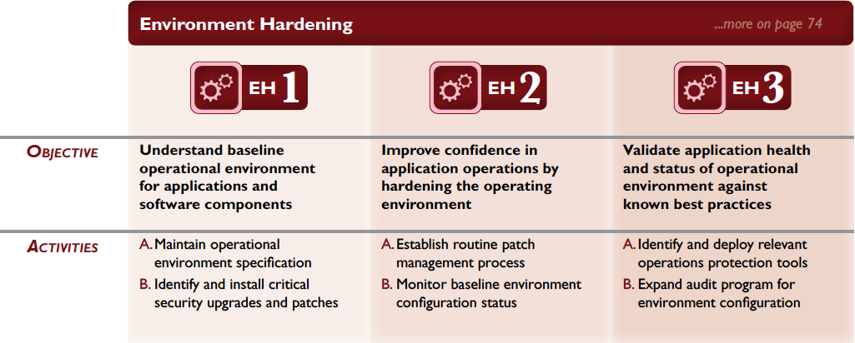
Environment Hardening

Slide 76
Operational Enablement
Support users & operators
Security documentation!
Feed/document application security logs into SIEM
Lightweight documentation => operational security guides
Change management & end to end deployment integrity
Even more important for outsourced development!

Slide 77
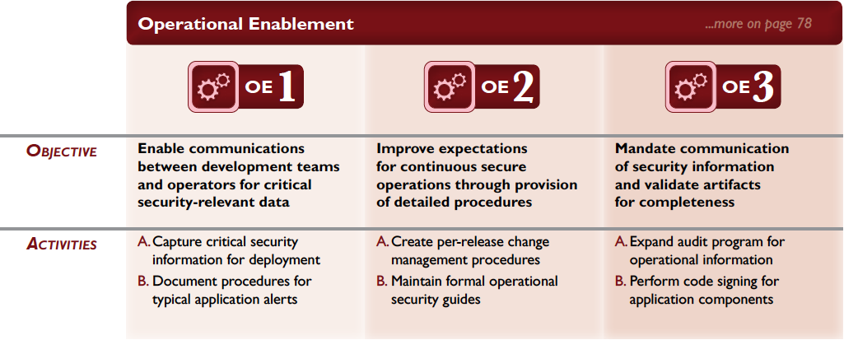
Operational Enablement

Slide 78
Assessment Exercise
Use OpenSAMM to evaluate the development practices in your own company
Focus on Deployment Business Functions
Applicable to both Waterfall and Agile models
Using distributed sheets and questionnaires

Slide 79
Assessment wrap-up
What’s your company’s score ?
What’s the average scores for the group ?
Any odd ratings ?

Slide 80
Improvement Exercise
Define a target for your company and the phased roadmap to get there
Focus on the most urgent/heavy-impact practices first
Try balancing the complexity and effort of the different step-ups

Slide 81
Tips
Roadmap templates can provide direction for targets
What type of company are you ?
Take into account the company’s risk appetite
Only include activities where you see added value for the company
Even for lower levels
OpenSAMM activities have dependencies – use them !
Think about links with other practices in the company
E.g., training, release management, …

Slide 82
Conclusion Applying OpenSAMM
Lightweight assessment of 12 security practices
Your thoughts:
Representative summary ?
New insights learned ?
Anything not covered ?
…

Slide 83
Today’s Agenda
Introduction to SDLC and OpenSAMM
Applying OpenSAMM
Methodology
Assessment Governance
Assessment Construction
Assessment Verification
Assessment Deployment
Setting Improvement Targets
OpenSAMM Tools
OpenSAMM Best Practices

Slide 84
OpenSAMM Tools
Translations of the OpenSAMM model (Spanish, Japanese, German)
Assessment questionnaire(s)
Roadmap chart template
Project plan template
OpenSAMM-BSIMM mapping
Mappings to security standards
ISO/IEC 27034, PCI, …

Slide 85
Implement: 150+ OWASP resources
PROTECT
Tools: Enterprise Security API (ESAPI), CSRFGuard, AppSensor, ModSecurity Core Rule Set Project
Docs: Development Guide, Cheat Sheets, Secure Coding Practices - Quick Reference Guide
DETECT
Tools: OWTF, Broken Web Applications Project, Zed Attack Proxy
Docs: Code Review Guide, Testing Guide, Top Ten Project
LIFE CYCLE
SAMM, Application Security Verification Standard, Legal Project, WebGoat, Education Project, Cornucopia

Slide 86
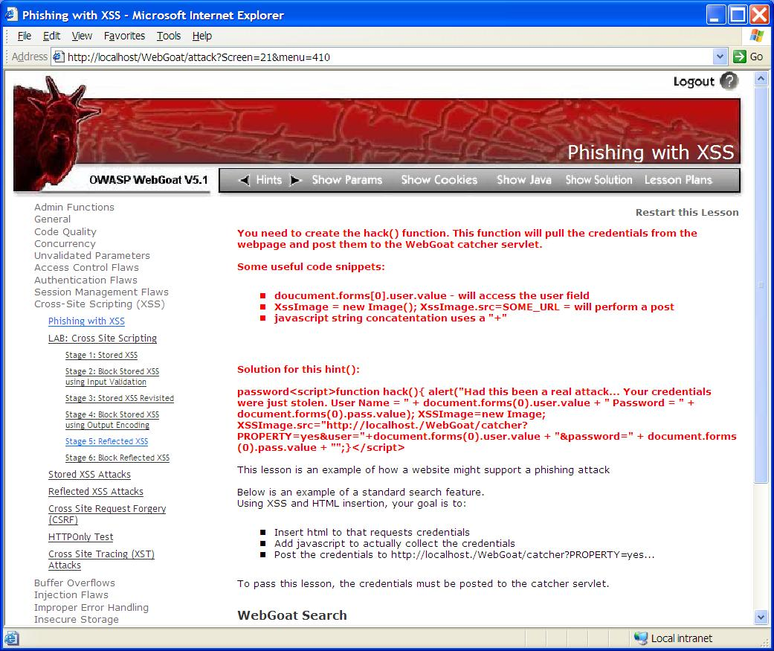
Education & Guidance
Resources:
OWASP Top 10
OWASP Education
WebGoat
Give a man a fish and you feed him for a day;
Teach a man to fish and you feed him for a lifetime.
Chinese proverb
A1: Injection
A10: Unvalidated Redirects and Forwards
A7: Failure to Restrict URL Access
A6: Security Misconfiguration
A5: Cross Site Request Forgery (CSRF)
A4: Insecure Direct Object References
A3: Broken Authentication and Session Management
A2: Cross-Site Scripting (XSS)
A8: Insecure Cryptographic Storage
A9: Insufficient Transport Layer Protection
https://www.owasp.org/index.php/Category:OWASP_Top_Ten_Project
https://www.owasp.org/index.php/Category:OWASP_Education_Project
https://www.owasp.org/index.php/Category:OWASP_WebGoat_Project

Slide 87
OWASP Cheat Sheets
Developer Cheat Sheets (Builder)
Authentication Cheat Sheet
Choosing and Using Security Questions Cheat Sheet
Cross-Site Request Forgery (CSRF) Prevention Cheat Sheet
Cryptographic Storage Cheat Sheet
DOM based XSS Prevention Cheat Sheet
Forgot Password Cheat Sheet
HTML5 Security Cheat Sheet
Input Validation Cheat Sheet
JAAS Cheat Sheet
Logging Cheat Sheet
OWASP Top Ten Cheat Sheet
Query Parameterization Cheat Sheet
Session Management Cheat Sheet
SQL Injection Prevention Cheat Sheet
Transport Layer Protection Cheat Sheet
Web Service Security Cheat Sheet
XSS (Cross Site Scripting) Prevention Cheat Sheet
User Privacy Protection Cheat Sheet
Assessment Cheat Sheets (Breaker)
Attack Surface Analysis Cheat Sheet
XSS Filter Evasion Cheat Sheet
Mobile Cheat Sheets
IOS Developer Cheat Sheet
Mobile Jailbreaking Cheat Sheet
Draft Cheat Sheets
Access Control Cheat Sheet
Application Security Architecture Cheat Sheet
Clickjacking Cheat Sheet
Password Storage Cheat Sheet
PHP Security Cheat Sheet
REST Security Cheat Sheet
Secure Coding Cheat Sheet
Secure SDLC Cheat Sheet
Threat Modeling Cheat Sheet
Virtual Patching Cheat Sheet
Web Application Security Testing Cheat Sheet
https://www.owasp.org/index.php/Cheat_Sheets

Slide 88
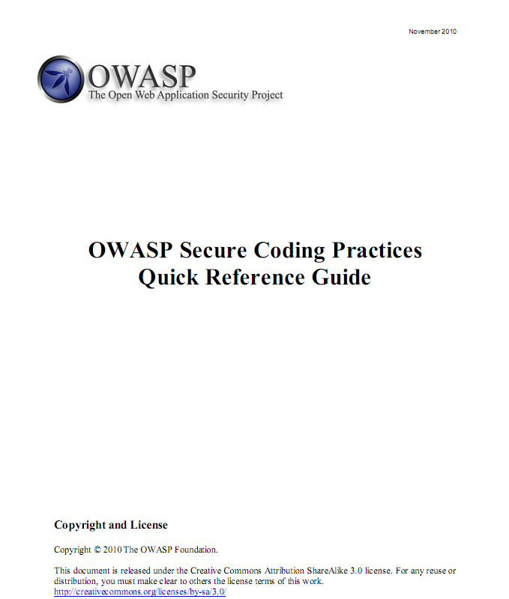
Secure Coding Practices Quick Reference Guide
Technology agnostic coding practices
What to do, not how to do it
Compact, but comprehensive checklist format
Focuses on secure coding requirements, rather then on vulnerabilities and exploits
Includes a cross referenced glossary to get developers and security folks talking the same language
https://www.owasp.org/index.php/OWASP_Secure_Coding_Practices_-_Quick_Reference_Guide
Notes:
The Secure Coding Practices Quick Reference Guide is a technology agnostic set of general software security coding practices, in a comprehensive checklist format, that can be integrated into the development lifecycle. At only 17 pages long, it is easy to read and digest.
The focus is on secure coding requirements, rather then on vulnerabilities and exploits. It includes an introduction to Software Security Principles and a glossary of key terms.
It is designed to serve as a secure coding kick-start tool and easy reference, to help development teams quickly understand secure coding practices.

Slide 89
The OWASP Enterprise Security API
Custom Enterprise Web Application
Authenticator
User
AccessController
AccessReferenceMap
Validator
Encoder
HTTPUtilities
Encryptor
EncryptedProperties
Randomizer
Logger
IntrusionDetector
Enterprise Security API
Exception Handling
SecurityConfiguration
Existing Enterprise Security Services/Libraries
https://www.owasp.org/index.php/Category:OWASP_Enterprise_Security_API
Notes:
ESAPI (The OWASP Enterprise Security API) is a free, open source, web application security control library that makes it easier for programmers to write lower-risk applications. The ESAPI libraries are designed to make it easier for programmers to retrofit security into existing applications. The ESAPI libraries also serve as a solid foundation for new development.
The ESAPI is a free and open collection of all the security methods that a developer needs to build a secure web application. You can just use the interfaces and build your own implementation using your company's infrastructure. Or, you can use the reference implementation as a starting point. In concept, the API is language independent. However, the first deliverables from the project are a Java API and a Java reference implementation. Efforts to build ESAPI in .NET and PHP are already underway.
The cost savings through reduced development time, and the increased security due to using heavily analyzed and carefully designed security methods provide developers with a massive advantage over organizations that are trying to deal with security using existing ad hoc secure coding techniques. This API is designed to automatically take care of many aspects of application security, making these issues invisible to the developers.
ESAPI (The OWASP Enterprise Security API) is a free, open source, web application security control library that makes it easier for programmers to write lower-risk applications. The ESAPI libraries are designed to make it easier for programmers to retrofit security into existing applications. The ESAPI libraries also serve as a solid foundation for new development.
Allowing for language-specific differences, all OWASP ESAPI versions have the same basic design:
There is a set of security control interfaces. They define for example types of parameters that are passed to types of security controls.
There is a reference implementation for each security control. The logic is not organization‐specific and the logic is not application‐specific. An example: string‐based input validation.
There are optionally your own implementations for each security control. There may be application logic contained in these classes which may be developed by or for your organization. An example: enterprise authentication.

Slide 90

Code Review
Resources:
OWASP Code Review Guide
SDL Integration:
Multiple reviews defined as deliverables in your SDLC
Structured, repeatable process with management support
Reviews are exit criteria for the development and test phases
https://www.owasp.org/index.php/Category:OWASP_Code_Review_Project

Slide 91
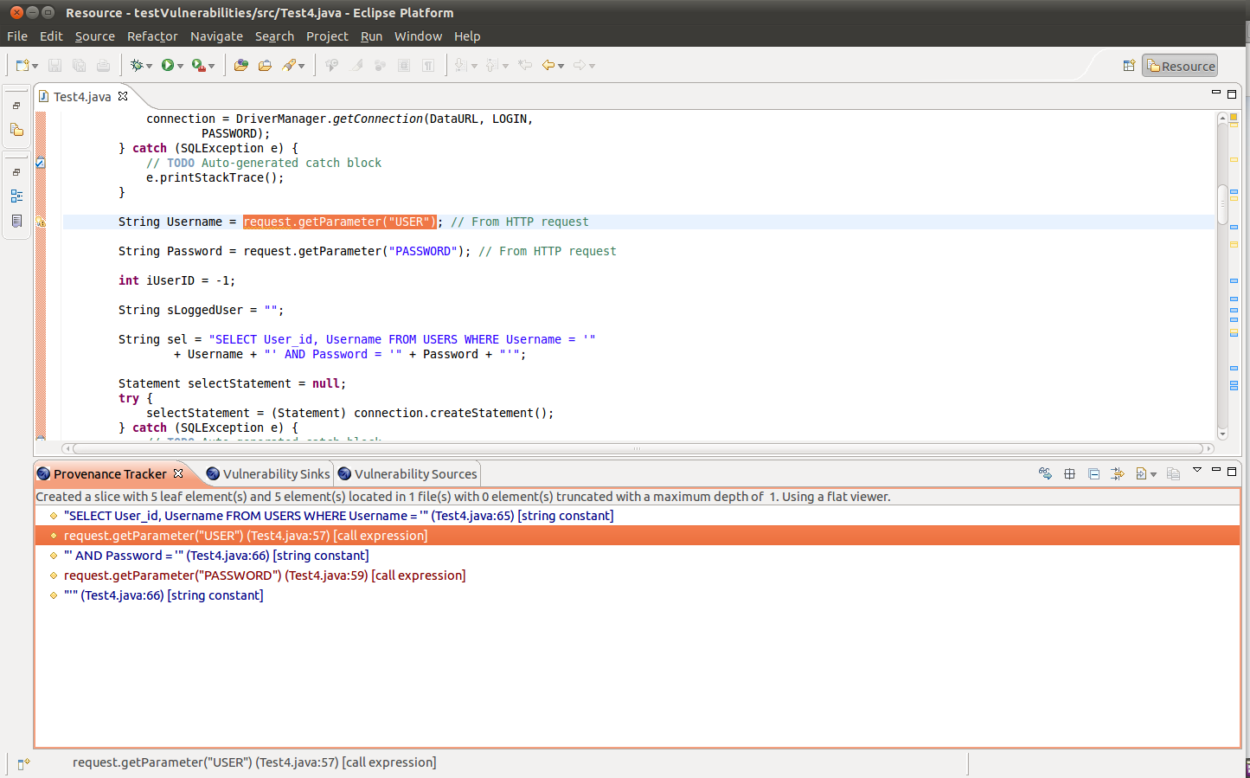
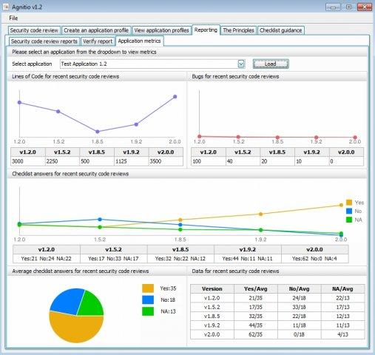
Code review tooling
Code review tools:
OWASP LAPSE (Security scanner for Java EE Applications)
MS FxCop / CAT.NET (Code Analysis Tool for .NET)
Agnitio (open source Manual source code review support tool)
https://www.owasp.org/index.php/OWASP_LAPSE_Project
http://www.microsoft.com/security/sdl/discover/implementation.aspx
http://agnitiotool.sourceforge.net/
Notes:
LAPSE+ is a security scanner for detecting vulnerabilities of untrusted data injection in Java EE Applications. It has been developed as a plugin for Eclipse Java Development Environment,
FxCop: An application that analyzes managed code assemblies for conformance to the Microsoft .NET Framework Design Guidelines
In addition to security checks, FxCop analyzes assemblies for areas of improvement in design, localization, and performance
CAT.NET is a snap-in to the Visual Studio IDE that helps you identify security flaws within a managed code (C#, Visual Basic .NET, J#) application you are developing. It does so by scanning the binary and/or assembly of the application, and tracing the data flow among its statements, methods, and assemblies. This includes indirect data types such as property assignments and instance tainting operations. The engine works by reading the target assembly and all reference assemblies used in the application -- module-by-module -- and then analyzing all of the methods contained within each. It finally displays the issues its finds in a list that you can use to jump directly to the places in your application's source code where those issues were found. The following rules are currently support by this version of the tool. - Cross Site Scripting - SQL Injection - Process Command Injection - File Canonicalization - Exception Information - LDAP Injection - XPATH Injection - Redirection to User Controlled Site
While MS has not released the new version, the good news is you can still use the old Add-in for CAT.NET 1.1.1.9 in Visual Studio 2010.
http://sourceforge.net/projects/agnitiotool/
A tool to help developers and security professionals conduct manual security code reviews in a consistent and repeatable way. Agnitio aims to replace the adhoc nature of manual security code review documentation, create an audit trail and reporting.

Slide 92

Security Testing
Resources:
OWASP ASVS
OWASP Testing Guide
SDL Integration:
Integrate dynamic security testing as part of you test cycles
Derive test cases from the security requirements that apply
Check business logic soundness as well as common vulnerabilities
Review results with stakeholders prior to release
https://www.owasp.org/index.php/Category:OWASP_Application_Security_Verification_Standard_Project
https://www.owasp.org/index.php/OWASP_Testing_Project

Slide 93

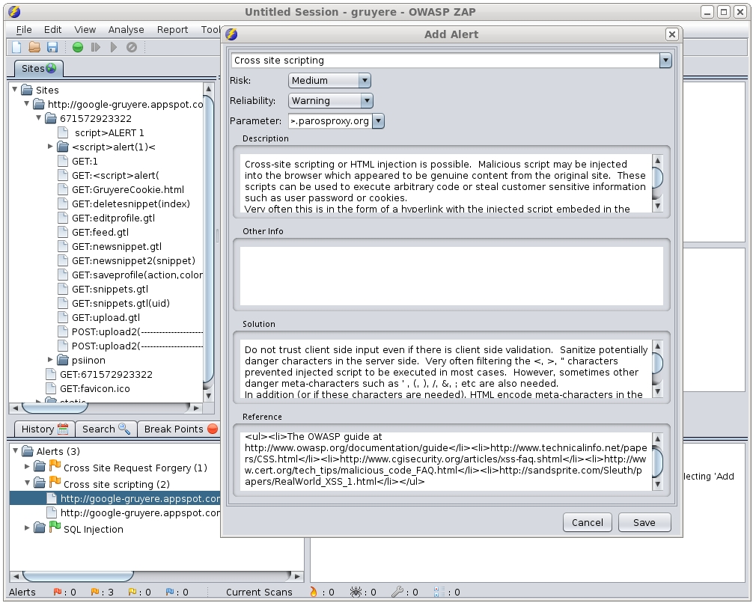
Security Testing
Zed Attack Proxy (ZAP) is an easy to use integrated penetration testing tool for finding vulnerabilities in web applications
Provides automated scanners as well as a set of tools that allow you to find security vulnerabilities manually
Features:
Intercepting proxy
Automated scanner
Passive scanner
Brute force scanner
Spider
Fuzzer
Port scanner
Dynamic SSL Certificates
API
Beanshell integration
https://www.owasp.org/index.php/OWASP_Zed_Attack_Proxy_Project

Slide 94

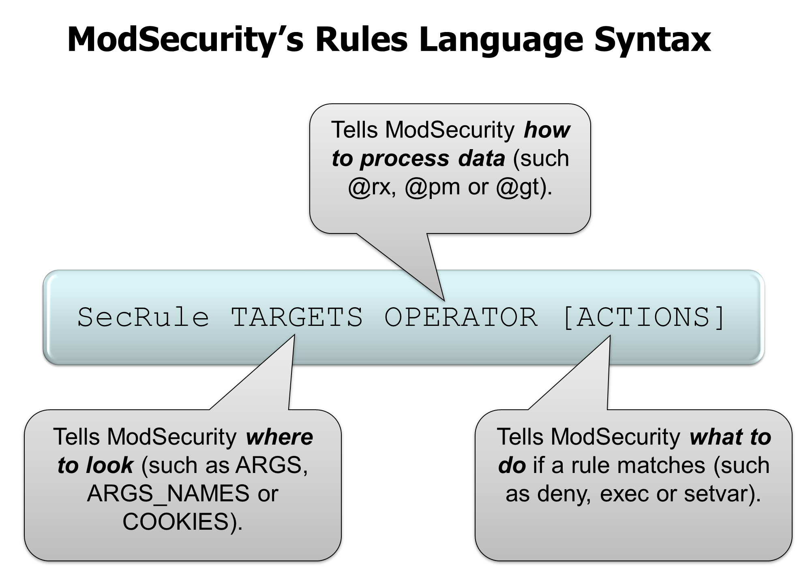
Web Application Firewalls
ModSecurity: Worlds No 1 open source Web Application Firewall
www.modsecurity.org
HTTP Traffic Logging
Real-Time Monitoring and Attack Detection
Attack Prevention and Just-in-time Patching
Flexible Rule Engine
Embedded Deployment (Apache, IIS7 and Nginx)
Network-Based Deployment (reverse proxy)
OWASP ModSecurity Core Rule Set Project, generic, plug-n-play set of WAF rules
https://www.owasp.org/index.php/Category:OWASP_ModSecurity_Core_Rule_Set_Project
Notes:
ModSecurity™ is a web application firewall engine that provides very little protection on its own. In order to become useful, ModSecurity™ must be configured with rules. In order to enable users to take full advantage of ModSecurity™ out of the box, Trustwave's SpiderLabs is sponsoring and maintaining a free certified rule set for the community. Unlike intrusion detection and prevention systems, which rely on signatures specific to known vulnerabilities, the Core Rules provide generic protection from unknown vulnerabilities often found in web applications, which are in most cases custom coded. The Core Rules are heavily commented to allow it to be used as a step-by-step deployment guide for ModSecurity™.
Core Rules Content
In order to provide generic web applications protection, the Core Rules use the following techniques:
HTTP Protection - detecting violations of the HTTP protocol and a locally defined usage policy.
Real-time Blacklist Lookups - utilizes 3rd Party IP Reputation
Web-based Malware Detection - identifies malicious web content by check against the Google Safe Browsing API.
HTTP Denial of Service Protections - defense against HTTP Flooding and Slow HTTP DoS Attacks.
Common Web Attacks Protection - detecting common web application security attack.
Automation Detection - Detecting bots, crawlers, scanners and other surface malicious activity.
Integration with AV Scanning for File Uploads - detects malicious files uploaded through the web application.
Tracking Sensitive Data - Tracks Credit Card usage and blocks leakages.
Trojan Protection - Detecting access to Trojans horses.
Identification of Application Defects - alerts on application misconfigurations.
Error Detection and Hiding - Disguising error messages sent by the server.

Slide 95
Today’s Agenda
Introduction to SDLC and OpenSAMM
Applying OpenSAMM
Methodology
Assessment Governance
Assessment Construction
Assessment Verification
Assessment Deployment
Setting Improvement Targets
OpenSAMM Tools
OpenSAMM Best Practices

Slide 96

The importance of a Business Case
If you want your company to improve, management buy-in is crucial
You will need a business case to convince them
Typical arguments:
Improved security quality
Better cost efficiency
Compliance
Risk management
Customer satisfaction
Reputation management

Slide 97
Entry Points
Pick the weak spots that can demonstrate short-term ROI
Typical examples
Awareness training
Coding Guidelines
External Pentesting
Success will help you in continuing your effort

Slide 98

Application categorization
Use this to rationalize security effort (according to the application risk)
Granularity !
Inter- Connectivity !

Slide 99

Communication & Support
Critical success factor !
Spreading the message – broad audience
Setup a secure applications portal !
Regular status updates towards management

Slide 100
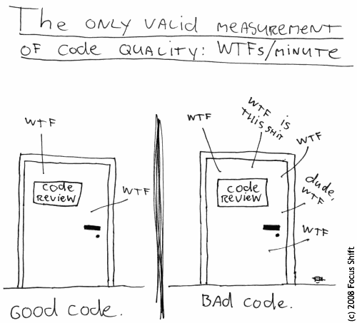
Monitoring & Metrics

Slide 101
Responsibilties
Core Security team
Security Satellite
Analysts
Architects
Developers
Operations
Management
Formalized RACI will be a challenge

Slide 102
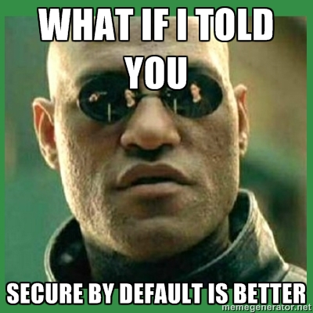
The Power of Default Security
Construct development frameworks that are secure by default
Minimizes work for developers
Will lower number of vulns.

Slide 103
Conclusions
Developing secure software gets more and more complex
OpenSAMM = global maturity foundation for software assurance
Applying OpenSAMM =
Assessment
Roadmap
(Continuous) Implementation
Be ready to face the organisational challenges that will pop up during the journey
Come and see us on Thursday morning !

Slide 104
SDLC Cornerstones (recap)
Process
Activities
Control Gates
Knowledge
Standards & Guidelines
Tools & Components
Deliverables
Transfer methods
People
Roles & Responsibilities
Compliance
Development support
Assessment tools
Management tools
Risk
Training
SecAppDev 2013
Notes:
Cfr. current E2E process, this is more extensive.
104

Slide 105
Thank you
105
Notes:
105

